Slide 1
Chainerator
Chianerator : The Most Flexible Blockchain Framework
Team Pabcon : 신재철, 정구익, 하현수, 홍상원

Slide 2
Index
01.
Project
Outline
02.
Motivation
03.
Researching
04.
Design Structure
05.
Expectation
&
Conclusion

Slide 3
Project Outline

Slide 4



01.
Project Outline
Modularization
Open Source
Lightweight Source Code
Blockchain Core
Function Modularization
Deploying Open Source
For Blockchain Core Developer And Getting Some Contribution
Develop Lightweight Blockchain Core

Slide 5
02. Motivation

Slide 6
02.
Problems in existing Project
Too Heavy
Blockchain Core’s Code is Too heavy to handling
Bitcoin Core : Approximately 100K Lines! Bytecoin Previous Version : 600K Lines!
So, We have to Develop lightweight blockchain.
Small Community
Blockchain Core is very difficult and complex, And
There is no framework for Start-Level Core Developer. So, we want to make Blockchain core framework such as Start-Kit.
Inflexible
Most Blockchain Project is very inflexible. Changing Consensus or Protocol is very hard because of Inflexible of Architecture

Slide 7
03. Researching

Slide 8


03.
Researching
Bitcoin
Litecoin
Bitcoin is the first Blockchain based Cryptocurrency, and it is open source.
It is difficult to modify flexibly as constant and variable are dependent by coin. Also, It is difficult to analyze source code because of poor modularization.
Litecoin is relatively easy to modify the blockchain property such as maximum amount of coin, hashing method, block size, and block creating time by removing restriction of modification in Bitcoin
Notes:
constitution으로 바꿈

Slide 9


03.
Researching
Peercoin
Bytecoin
Peercoin is based on Bitcoin and changed Proof-of-Work(POW), which is a consensus algorithm to Proof-of-Stake(POS)
Existing code and new Peercoin codes are mixed in a disorderly. so, It is still lacking in flexibility and modularization to using
Bytecoin is the first independent Blockchain to have nothing to do with the Bitcoin.
Created with its own Blockchain Core technology called Cryptonote, It is relatively easy to modify the value of the Blockchain Properties, but the source code extensive and poorly modular

Slide 10
04. Design Structure

Slide 11
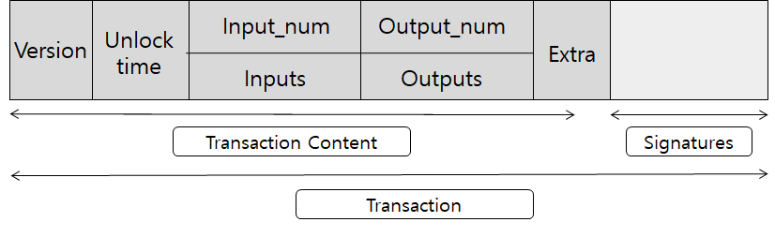
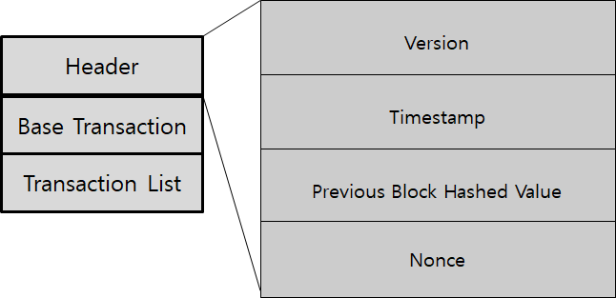
04.
Design Structure
< Transaction Structure >
< Block Structure >

Slide 12
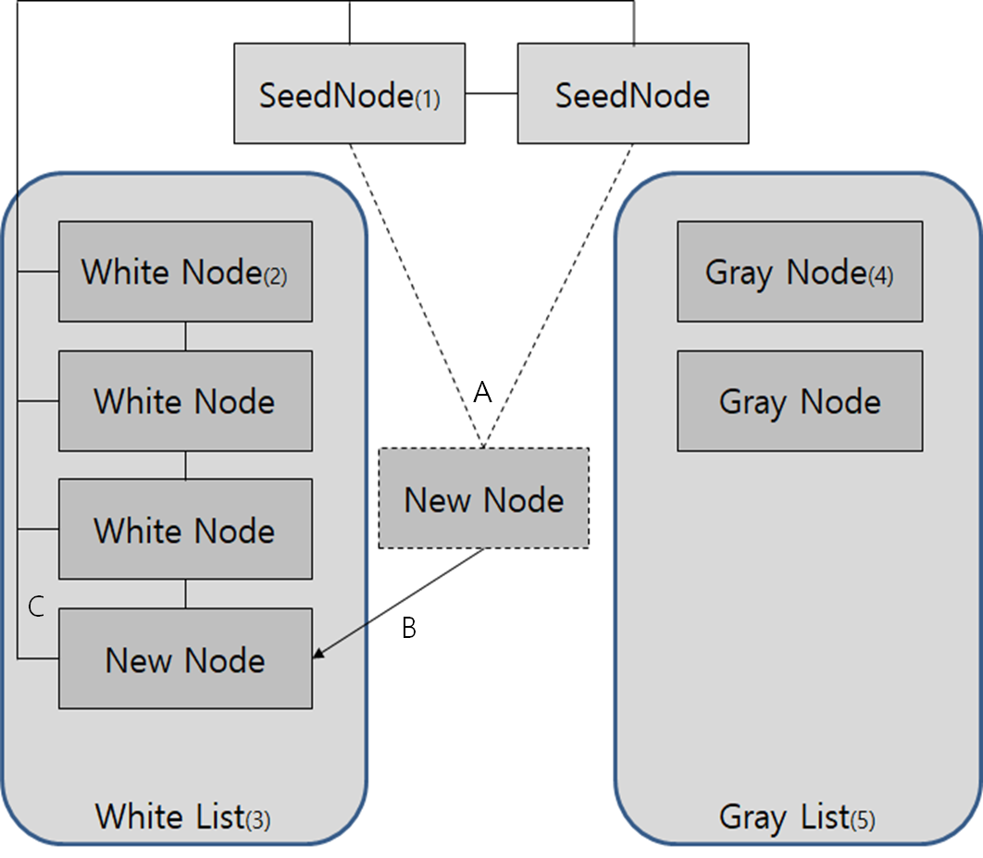
04.
Design Structure
SeedNode
This is the first node in the network and the other nodes are connected to that node first when they are first connected
White Node
Nodes currently operating connected to the network with P2P
Gray Node
Nodes that participated in the P2P network but is currently disconnected and each has a White List at the time of the termination.
< P2P Network Structure >

Slide 13
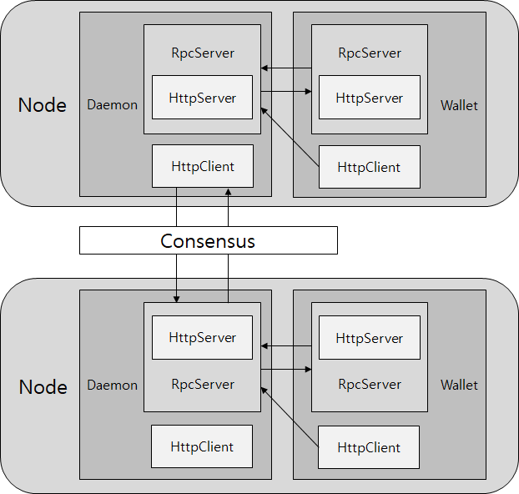
04.
Design Structure
Each node has a Daemon and Wallet, which uses an RPC Server and an HTTP Server to communication with external nodes and processes.
When communicating between nodes and processes, the demander forwords a JSON written signal and method execution request and receive the State value or JSON result accordingly.
< Blockchain Network Structure >

Slide 14
05. Conclusion

Slide 15
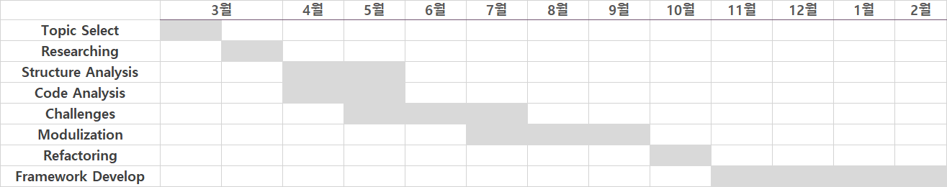
05.
Roadmap
Consensus

Slide 16

05.
Expectation Effect
Consensus
The Blockchain Core Developers can make more flexible blockchain for their own network by using our Open Source.

Slide 17
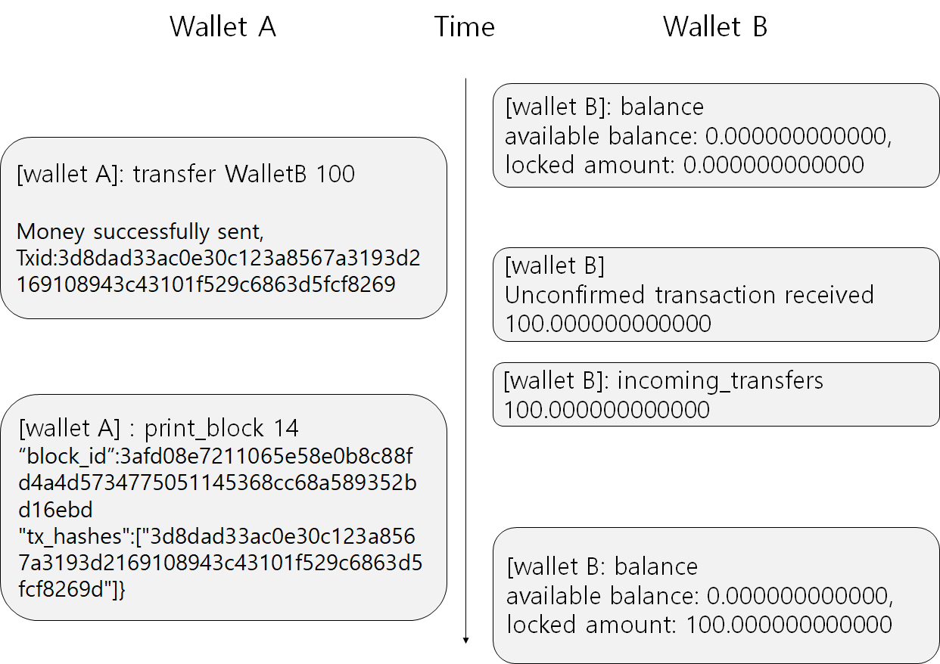
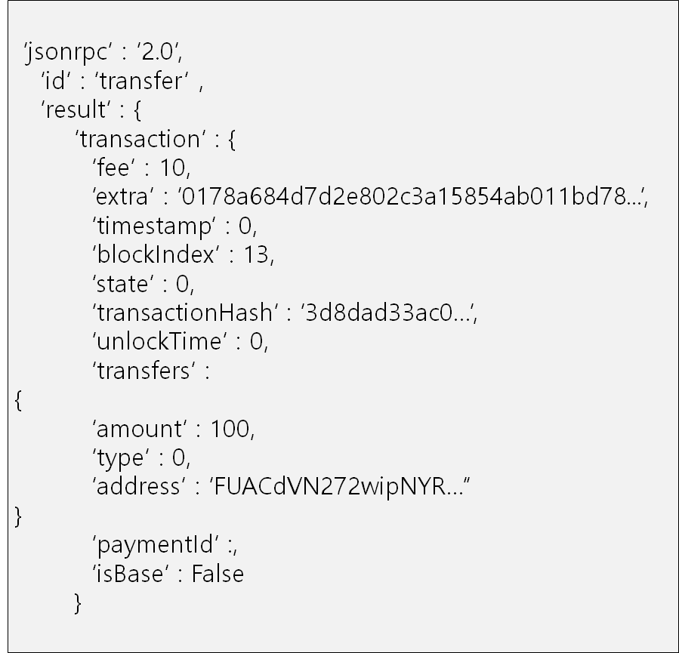
05.
Development Status
<Transfer in Wallet>
<Result JSON of Transaction>

Slide 18
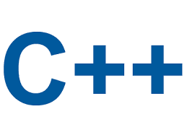

05.
Challenges
Most of Blockchain Project Developed by C++, but C++ has very complex architecture and code dependency problem.
So, If we want to make flexible and lightweight framework,
we have to change programming language to more lightweight programming language such as go, javascript.

Slide 19
Thank You
Name : Hyun-Soo HA (CryptoSalamander)
Email : dhy03196@naver.com
Tel : 010-9367-7178
Name : Gu-Ik Jung (Pandog)
Email : rndlr96@gmail.com
Tel : 010-4816-4676
TEAM MEMBERS
Name : Sang-Won Hong (qpakzk)
Email : qpakzk@gmail.com
Tel : 010-8774-7599
Name : Jae-Chul Shin (JCGOD)
Email : jcgod413@gmail.com
Tel : 010-8939-9673

